Slide 1



Key Stage 2
Postcards through time, a chronological adventure
Enquiry title: How has Kents Cavern been used from the Stone Age to today?

Slide 2
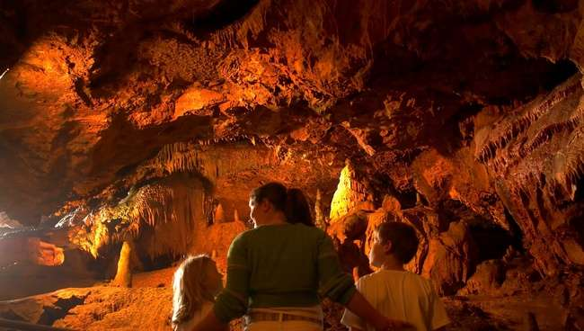
Key Question 1:
Why is chronology important in understanding the history of Kents Cavern?
First of all, let’s find out what you know about the Stone Age by playing true or false. If you think a statement is true, put your hand up. If you think it is false, keep your hand down.

Slide 3
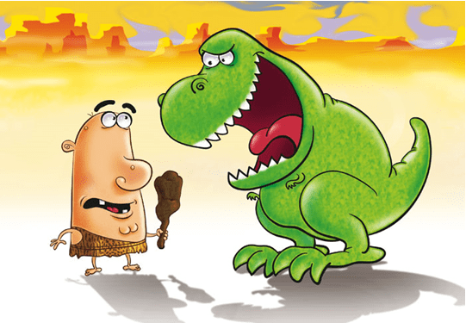
Dinosaurs lived during the Stone Age
FALSE, the dinosaurs died over 60 million years before the Stone Age started.

Slide 4


Stone Age people ate
McDonalds
FALSE, McDonalds was not around during the Stone Age.

Slide 5
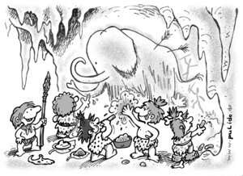
The Stone Age accounts for 99% of Human history
TRUE!

Slide 6
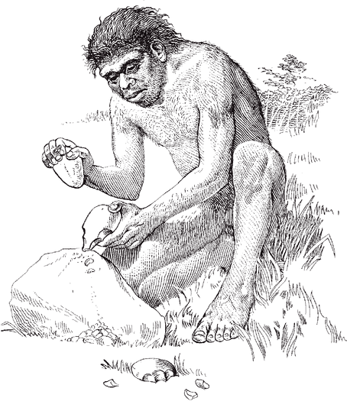
During the Stone Age, people made weapons out of bone and flint
TRUE!

Slide 7
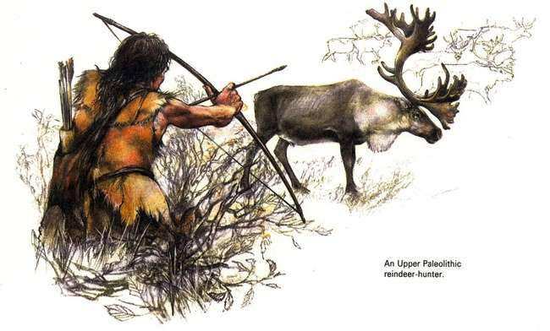
Stone Age people had to hunt and gather their food instead of going to the shops
TRUE!

Slide 8
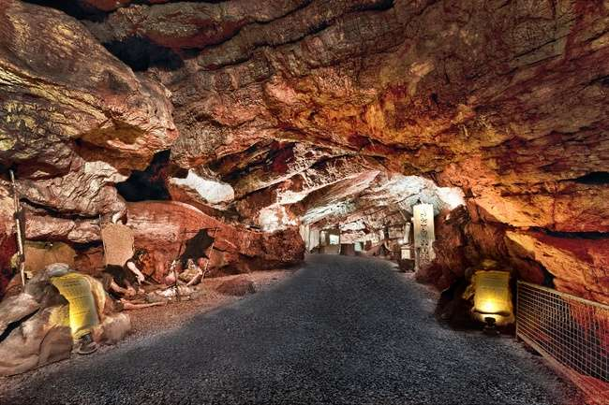
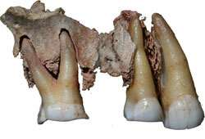
Kents Cavern
One of the most important prehistoric caves in Europe is Kents Cavern in Torquay.
Over 80,000 archaeological artefacts have been found there, some of the oldest are 700,000 years old.
A human jawbone was found in 1927. it dates to 41,000 years ago and is the oldest modern human remains ever found in our country.
The caves have been used as a shelter for people and animals ever since the Stone Age
Kents Cavern Jawbone

Slide 9
What is Chronology?
Chronology is the arrangement of dates in the order of when they happened.
It is important for archaeologists to know how old each artefact they find in the cave is, so they can create their own timeline of events at Kents Cavern.
Lots of different animals lived around Kents Cavern at different points during the Stone Age. Archaeologists can find out how old their bones are and know which animals were here first.
One of the easiest ways to sort things into chronological order is with a timeline. It can show events in a day, year or even 1000’s of years.
Now you’re going to be introduced to 3 of the animals which were found in the caves. Some of them lived in there, and some of them were brought in as food from outside. See if you can guess as they appear on the screen.

Slide 10
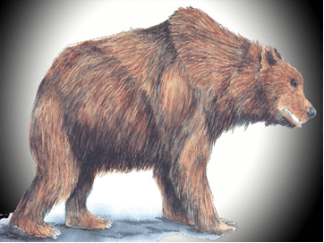
Bears
Did they live inside or outside of the caves?
Bears did live in the cave! Every winter they would hibernate in Kents Cavern.

Slide 11
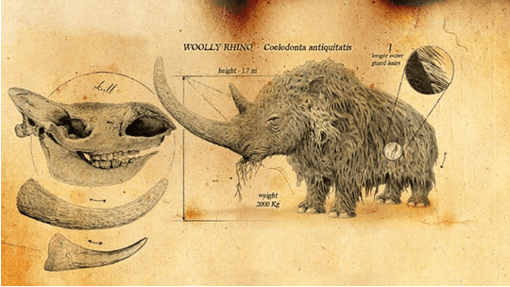
Did they live inside or outside of the caves?
Woolly Rhino
Did not live in the cave! They lived outside and would have been hunted by the animals that did live inside.

Slide 12
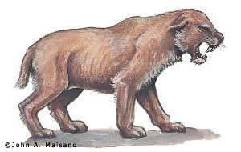
Did they live inside or outside of the caves?
Scimitar cat
We don’t know if these animals lived in the cave or not. 12 of their teeth were found inside but archaeologists believe that they might have been collected by people from further away and kept as good luck charms.

Slide 13
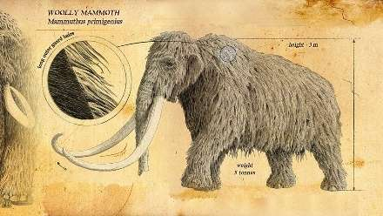
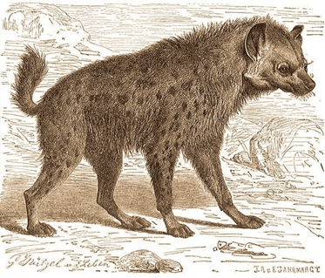
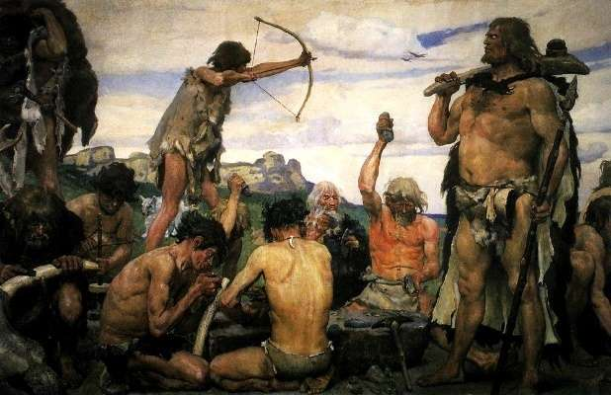
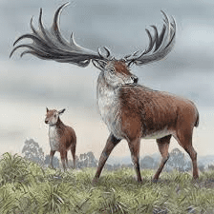
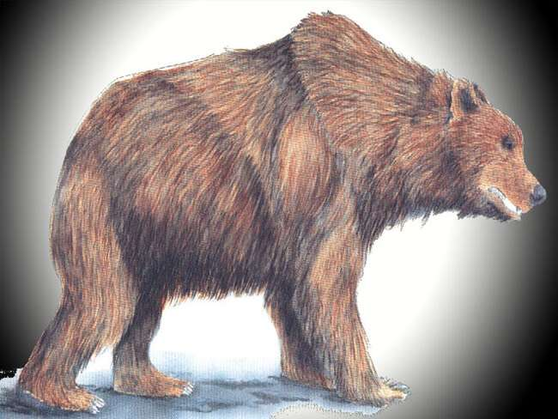
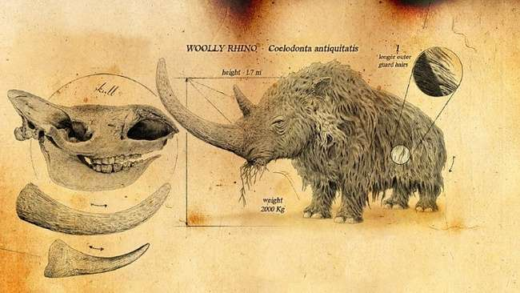
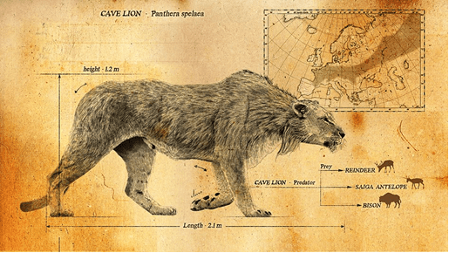
Timeline Activity
Using your Kents Cavern cards, work in a group to create a timeline of things at Kents Cavern. See if you can get it right without looking at the answers on the next slide!

Slide 14
Answers
1 Kents Cavern, Rock + Cave
2 Cave Bears
3 Hyenas
4 Cave Lion
5 Scimitar cat
6 Woolly Rhino
7 Woolly Mammoth
8 Irish Elk
9 Neanderthal
10 Homo Sapiens
11 Romans
12 Victorians
13 Us
These things were all in and around Kents Cavern throughout history, although they were all over other parts of the world. Maybe some of them lived where your school is today? Their bones might be buried under your playground! Use your imagination and draw what your playground might have looked like in the Stone Age.
You can find out more about each of these things by looking at the fact files which we have made for you.
You could create a timeline around your classroom and put each of the cards in the correct places along the way.

Slide 15
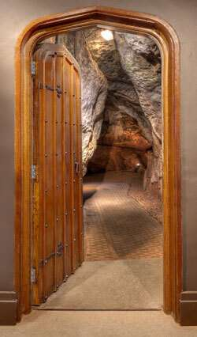
Kents Cavern
You will be visiting Kents Cavern soon, and have the chance to wander through a real Stone Age home.
Before your visit, we’re going to explain about how the cave was made.
It’s a really really long process and happened over 385 million years ago. But we’re going to tell the story in 2 slides!

Slide 16
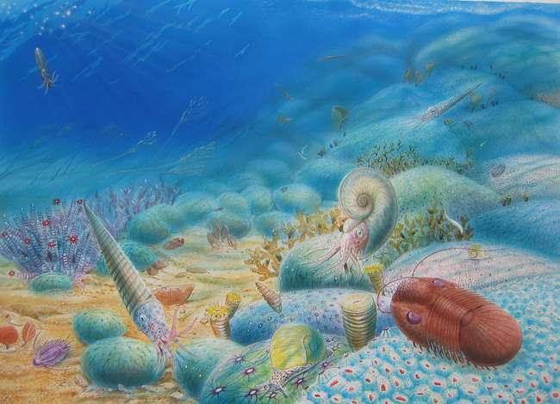
385 million years ago, under the sea near Africa, fish and corals began to die. When this happened, their bones sank to the sea bed and started to join together into one big lump which turned into rock. This rock has a special name, Limestone.
These are some of the animals which lived in the sea 385 million years ago, dying and forming the limestone rock which makes Kents Cavern.
That rock then began to move, on top of tectonic plates which are under the crust of the earth, to where it is today.

Slide 17
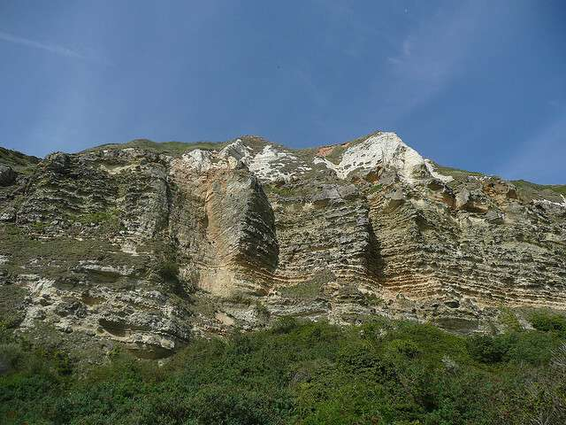
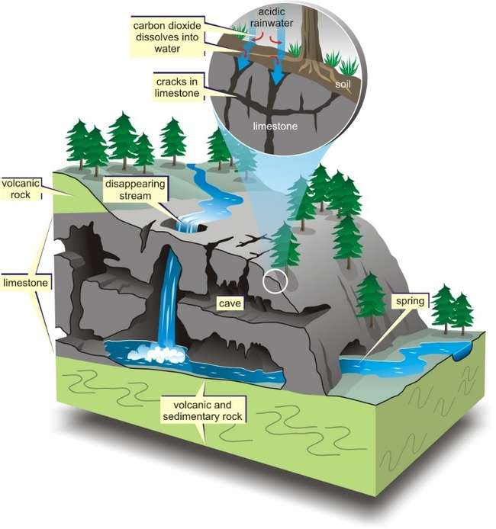
So, Kents Cavern for millions of years was just one big lump of rock on the side of a cliff, until eventually, a river started running into it.
The river started hitting the rock on one side and eventually started eating away through the rock, until it came out of the other end.
Limestone cliff
The water had made a huge set of passageways and chambers inside the rock. One day, the water stopped flowing through and animals and people decided it would make a perfect place to stay!
Limestone caves being formed

Slide 18
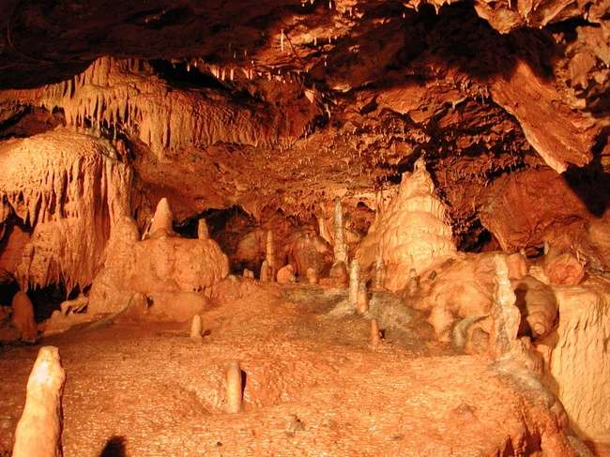
Chronology of cave formations
Lets see if you managed to understand chronology. Use the cave formation resources arrange them into the order of how caves are formed.
See if you can match the right pictures to the right information.
Don’t worry if you get it wrong. The answers are coming up on the next slide!

Slide 19
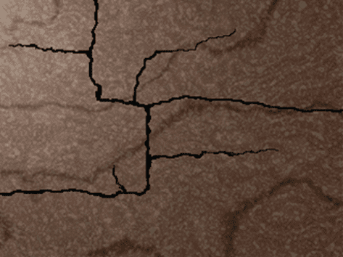
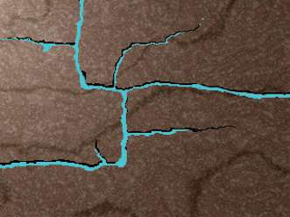
Answers
1
Small cracks begin to form in the rocks and rainwater gradually seeps through. Weak acids in the water slowly etch away the rock and enlarge the fissures
2
The big cracks become filled with water, sometimes with lots of force. The water swirls about underground taking out areas of rock and beginning to form passageways.

Slide 20
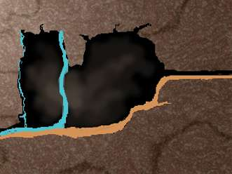
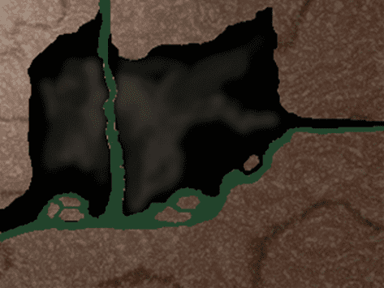
As time goes on, the level of water in the surrounding area drops. Air spaces are formed in the cave as the water reduces. Water still trickles in from the roof and the passageways start getting bigger. As the cracks get bigger, mud and stones wash into the cave and build up on the floor.
3
Chunks of rock, all different sizes, begin to fall from the walls and ceiling of the cave, making the chamber larger. The rocks are covered by the mud and stones that are continuously worked in to form the cave floor.
4

Slide 21
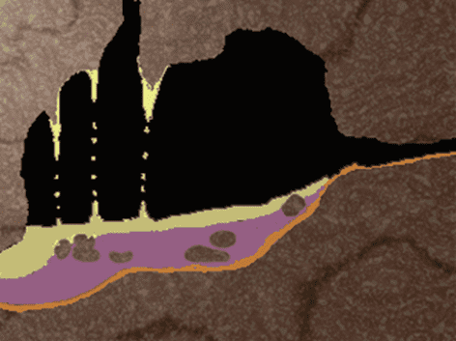
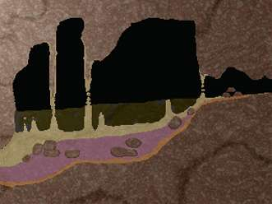
Limestone dissolved by the trickling water is deposited as stalactites hanging from the ceiling. As the water drips onto the base of the cave, the water is deposited as stalagmites, growing up in layers coating the walls or covering the floor. The layers of stalagmite on the floor can grow very thick and seal the mud and rock underneath.
5
As the process of erosion and filling up of the cave took place, the remains of animals also found their way into the cave and become buried and preserved by the layers of mud and stalagmite. Eventually the process begins to slow down as less and less water trickles through the rock.
6

Slide 22
Now that you’ve got the hang of chronological order, write a sentence explaining why it is important in understanding the history of Kents Cavern.

Slide 23
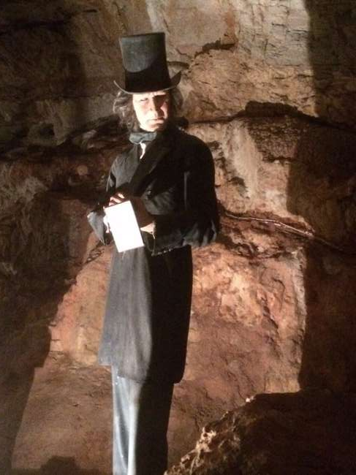
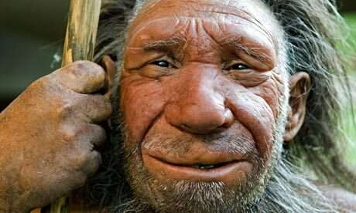
Key Question 2:
Who used Kents Cavern and for what?
You’ve already learnt some of the answers, but there are lots of others. You will be going on a class trip to Kents Cavern soon to find out what they are.
Before your trip, have a think about what Kents Cavern might have been used for from the Stone Age to today.

Slide 24
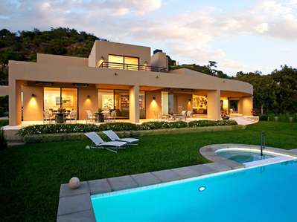
Now that you have visited Kents Cavern, you should have a better understanding that the cave was used as a home for lots of different living things.
BUT, what makes the perfect home?
Write a couple of sentences about your dream home.
Where is it?
Who lives there?
How many rooms does it have?
What can you do there?
Is it near anything fun?

Slide 25

Here is a list, put together by our friends at Bettesworths estate agents. It shows you some of the most important things for your house to have to make it more sell-able.
Driveways
Paths
South facing Garden
Lawn
Fencing
Good Roof
Clear spaces
Good Light
Extensions
Garages
Updated bathroom
Updated kitchen
Central heating
Double glazing
Rooms with purpose
Good air flow
Floor space
No pets
Pricing
Colourful fabrics
Good services e.g. Gas, Electric, Water
Conservatory
Good storage space
Good schools nearby
Close to local amenities
Do you think any of these would have been relevant for Stone Age people?

Slide 26

Have a look at the information packs we have from Bettesworths, trying to sell some local houses.
What sort of language do they use?
Are there any pictures?
In the same style, try and design a front cover for a pack aimed at selling Kents Cavern.
However, you will not be writing this as a modern person. You will have to be a Stone Age estate agent.
Do you think Stone Age people cared which way their garden faced? Or if there were animals living in the same home? Have a look at the list again and decide which ones you might write about and come up with some of your own based on everything you have learned about the Stone Age so far. When you’ve done this, create your front cover for Kents Cavern.

Slide 27
Key question 3: What might the area around Kents Cavern have looked like for the different people who used the caves?
For this last part of your topic, you’re going to try and imagine what Kents Cavern might have looked like for visitors during the Stone Age, and also when the romans visited.
You know what the area looks like today because you visited for yourselves, but there are also pictures on the internet which you could look at as well.
We also have some pictures of what Kents Cavern looked like during the 1800’s for the excavators. You can see them on the next slides.

Slide 28
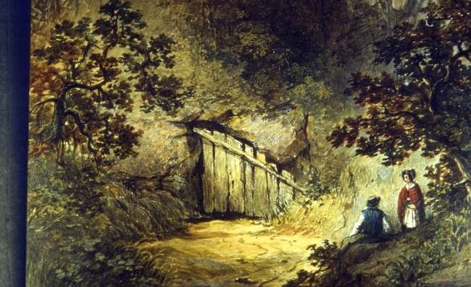
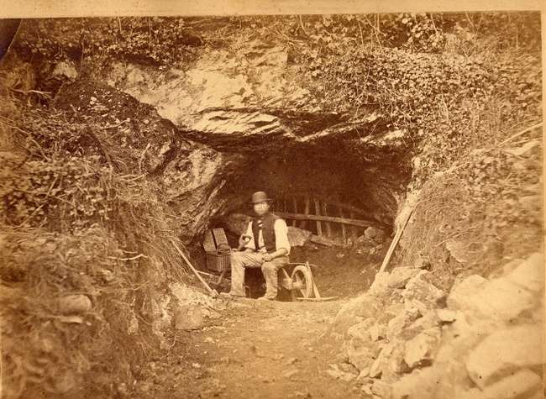
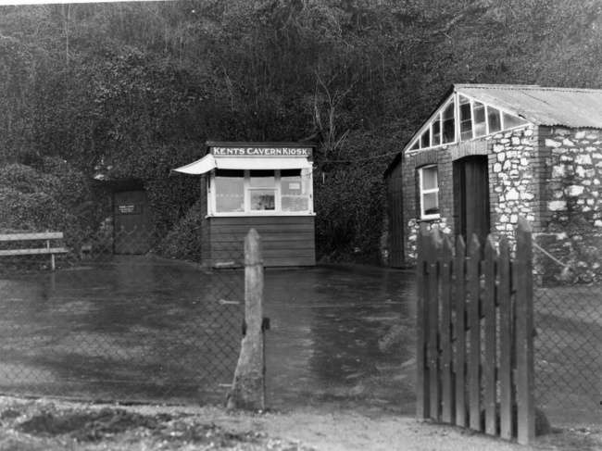
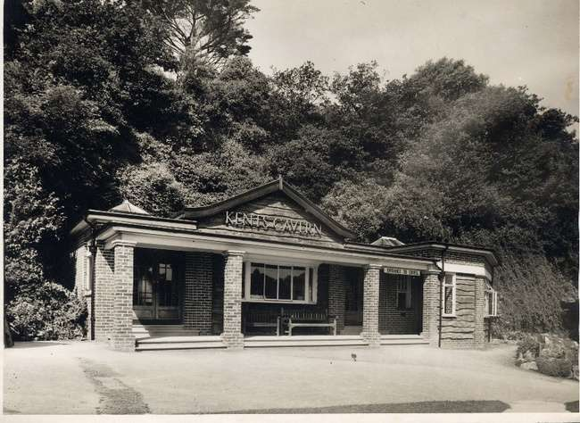
18th Century entrance to Kents Cavern (today this is the exit).
George Smerdon (excavator) working in the 1870’s.
Kents Cavern reception 1920’s
Kents Cavern reception 1940’s

Slide 29
There are no paintings or photographs from the Stone Age or from when the romans visited us. But we do know what animals were alive at the time, and also what each person living might have looked like.
You are going to use your imagination to come up with the design for two postcards. One from Kents Cavern during the Stone Age, and one from when the Romans visited.
Here are some questions to help with your design;
What animals can you see?
Are there any other people around?
What plants are there?
What’s the weather like?

Slide 30
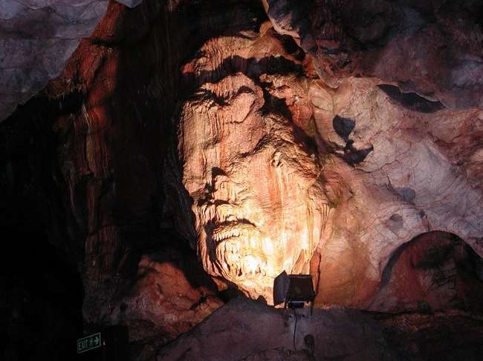
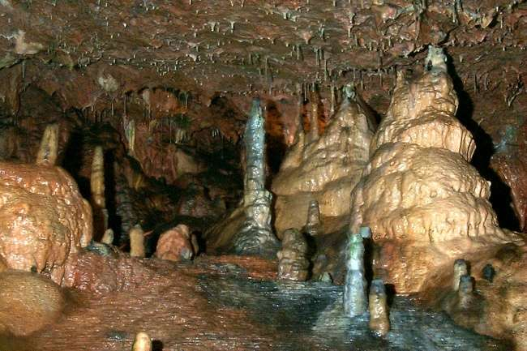
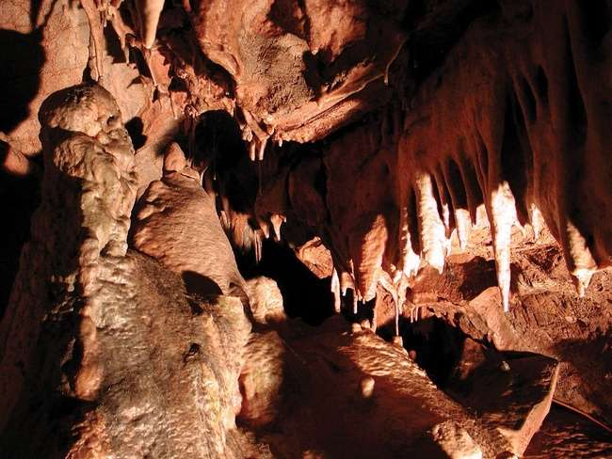
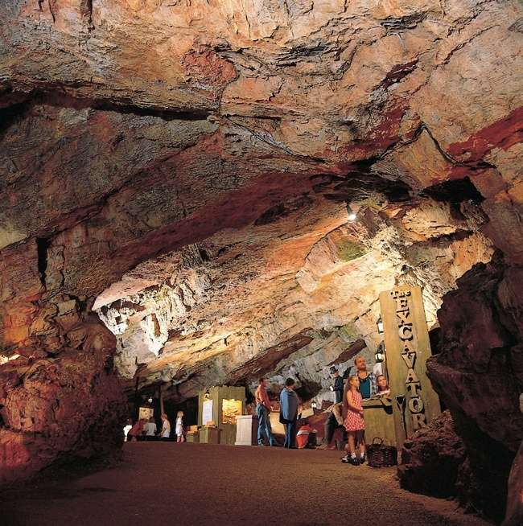

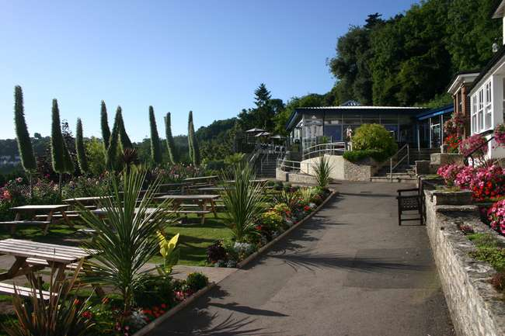

Slide 31
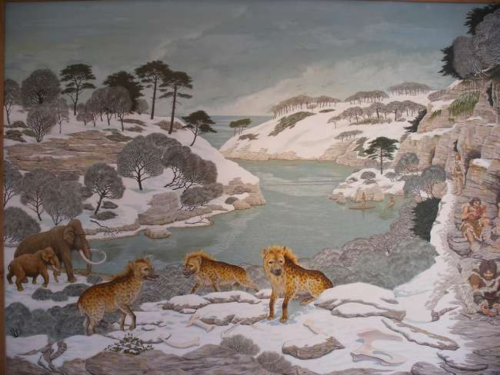
This is an artists’ interpretation of what the valley around Kents Cavern might have looked like during the Ice Age.

Slide 32
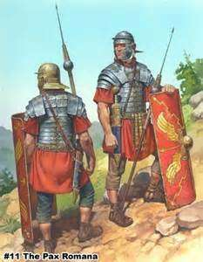
Now use the information you know about the cavemen and Romans at Kents Cavern to write on the back of the postcard from their perspectives.
Remember to write in chronological order, starting with what happened first and ending with the last part of the day, you can make up information like what the weather was like and how you felt but make sure you write about things that are specific to the time, don’t write a postcard from a Roman describing the Woolly Mammoths that they saw because they were extinct!
Here’s some things to think about;
Would the cavemen talk about the dangers in the cave?
did they go hunting?
Was it a success or are they going hungry tonight?
Would the Romans mention that they saw Mithras, their god of caves?
How did the caves make them feel?
If you finish with time to spare, why not design a postcard from the perspective of the Victorian excavators.
Were they tired from all of the hard work?
were they excited because they made a new discovery that day?

Slide 33
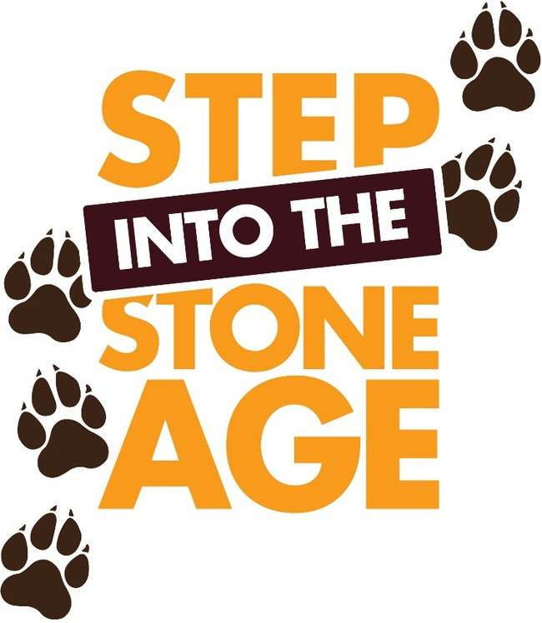
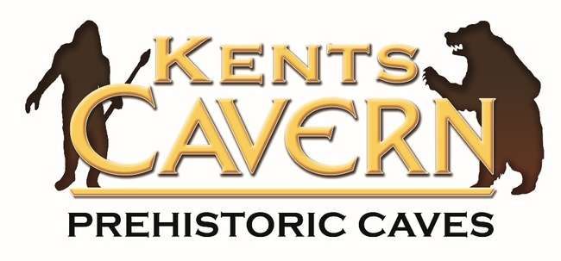
You’re now at the end of the topic! Hopefully you’ve all enjoyed learning about how Kents Cavern has been used since the Stone Age, and you’ll come back to visit soon!
If you want one last activity for before the topic is over, you could write a letter to us telling us about your topic.
Did you enjoy learning about the Stone Age?
What did you already know?
What did you learn?
What did you like most or least?
Did you enjoy your trip to the cave?
What would you like to learn more about?
You can tell us anything you want!
Our address is:
Kents Cavern Prehistoric Caves
Ilsham Road
Torquay
Devon
TQ1 2JF

